Slide 1
House Price Regression Modelling Project
Nat Berryman

Slide 2
Summary
The purpose of this regression model is to predict the house prices in King County by analysing the King County House Sales dataset.

Slide 3
Outline
Business Problem
Cleaning the Data
Exploratory Data Analysis
Models
Conclusions

Slide 4
Business Problem
How can we predict the house price sales in King County?
In order to solve this problem, I intended to answer the below questions:
1. Does location impact sale price?
2. Does the size of the house impact sale price?
3. Does quality of the house impact sale price?

Slide 5
Cleaning the Data
Dropped unnecessary data
Replaced or removed null values
Narrowed data to only included houses with <6 bedrooms
Using the empirical formula I removed outliers
Addressed multicollinearity
Split data set between continuous and categorical data
Binned Grade into Low, Average and High

Slide 6
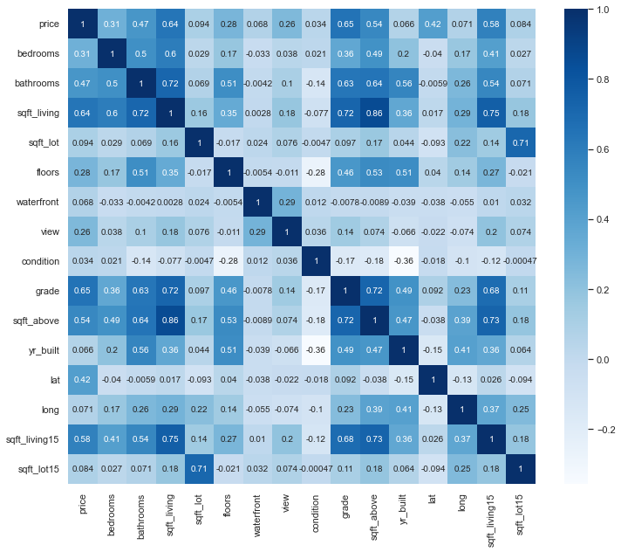
Exploratory Data Analysis
Key Features include:
Bathrooms
Square Foot living space
Grade
Latitude
Square Foot Above
Square Foot Living 15 (neighbors)
Notes:
Zip code excluded as data-type is a string
Latitude correlates with price more than Longitude

Slide 7
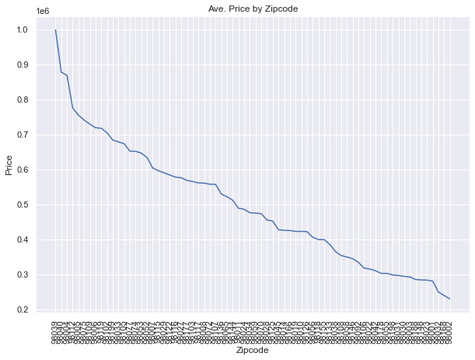
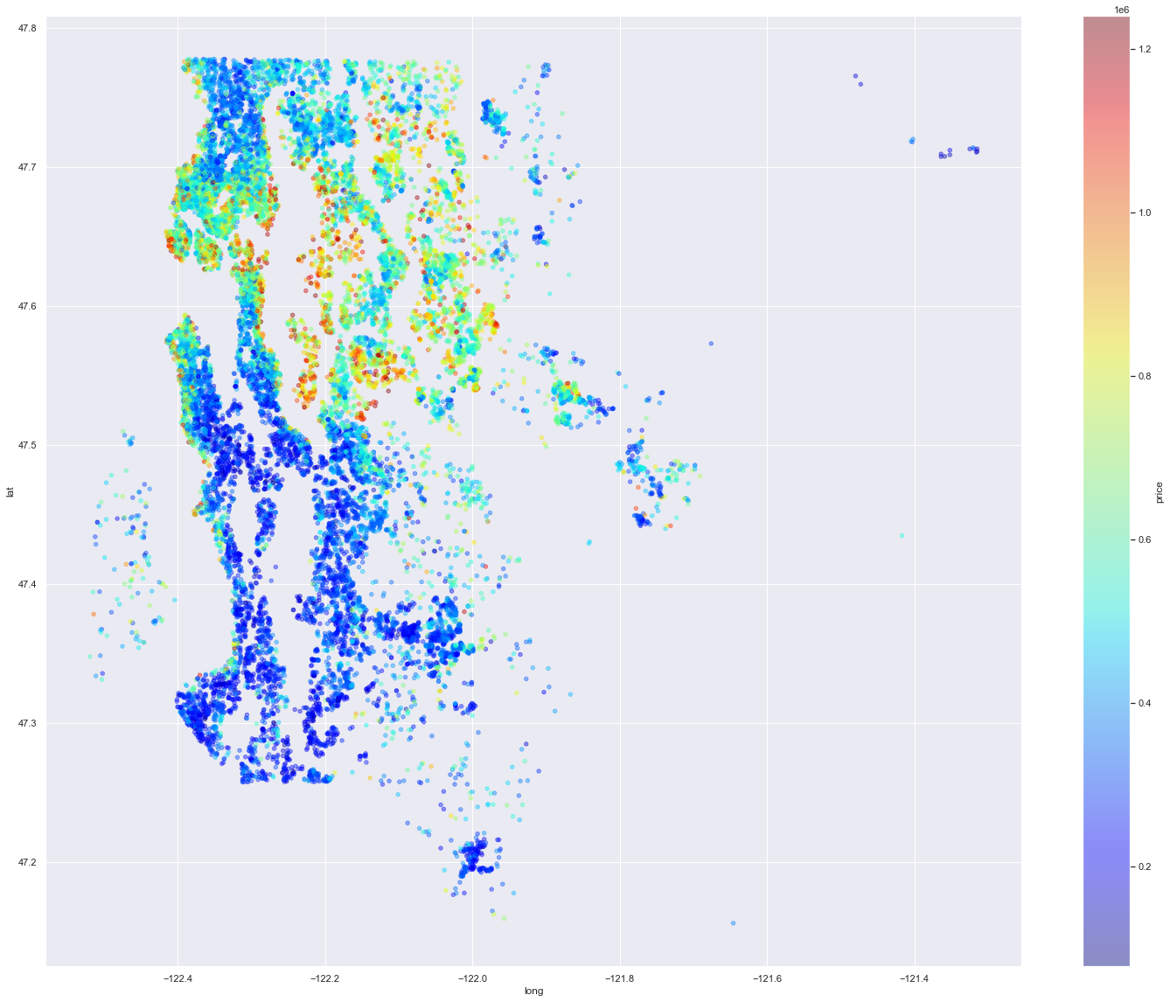
Exploratory Data Analysis
Created price vs zip code graph to explore price distribution across zip codes and then plotted to a heatmap.
Using these visualization I created a new variable – Distance from CBD

Slide 8
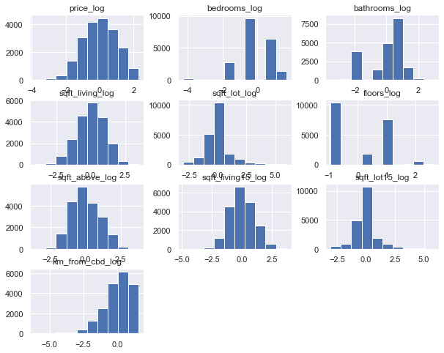
Exploratory Data Analysis
Used mean normalization to standardise the data
Sqft living, sqft lot, sqft above, sqft living 15, sqft lot 15 appear good
Km from CBD is negatively skewed

Slide 9
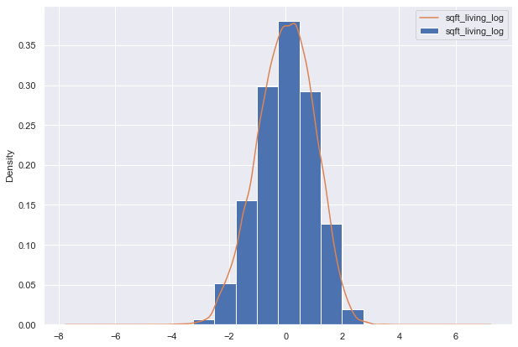
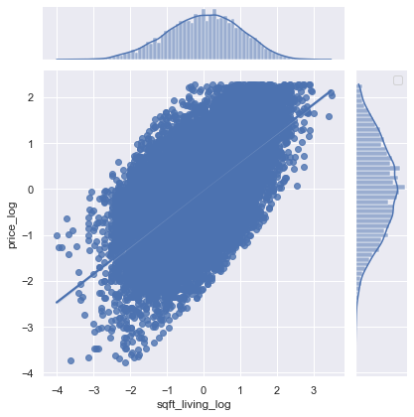
Exploratory Data Analysis
Used KDE plot and joint plot to explore data

Slide 10
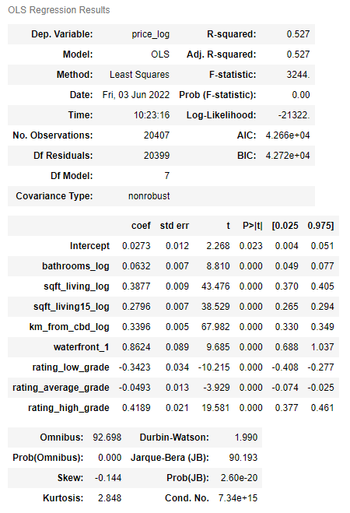
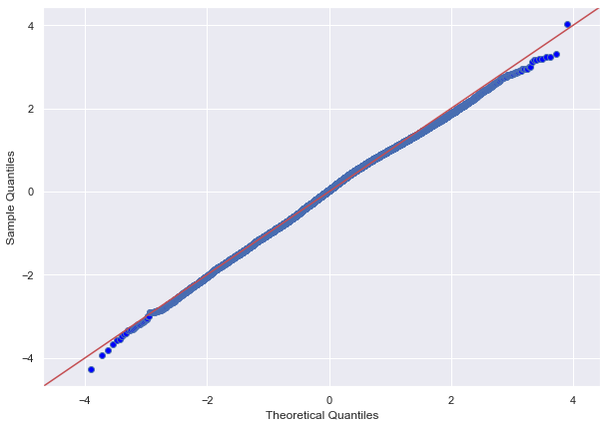
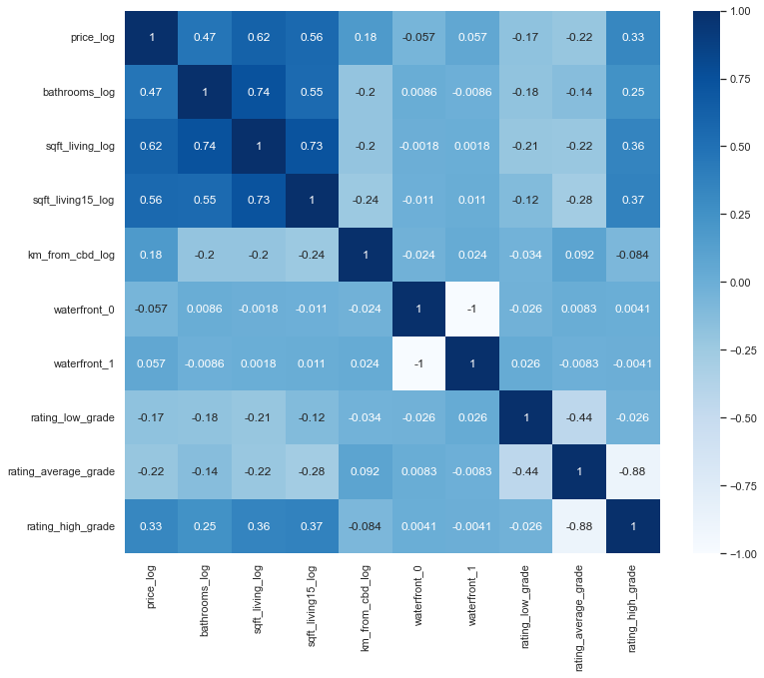
Model 1

Slide 11
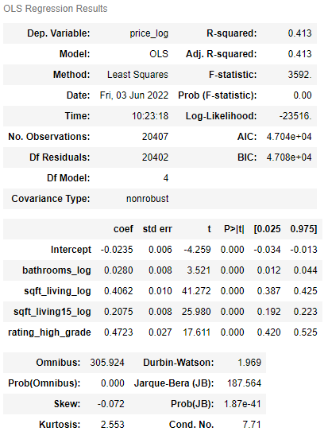
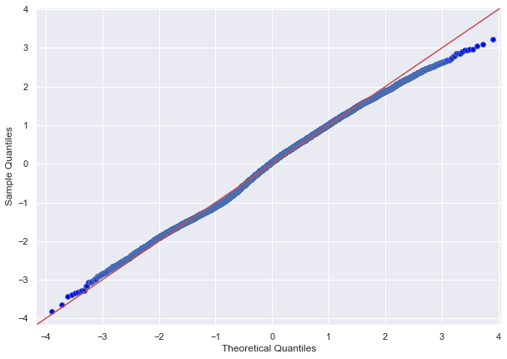
Model 2

Slide 12
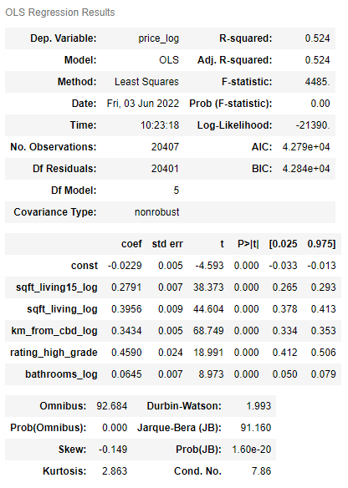
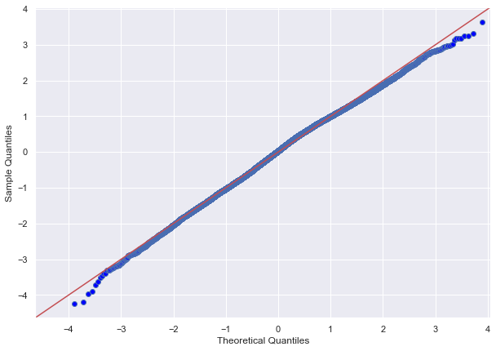
Model 3

Slide 13
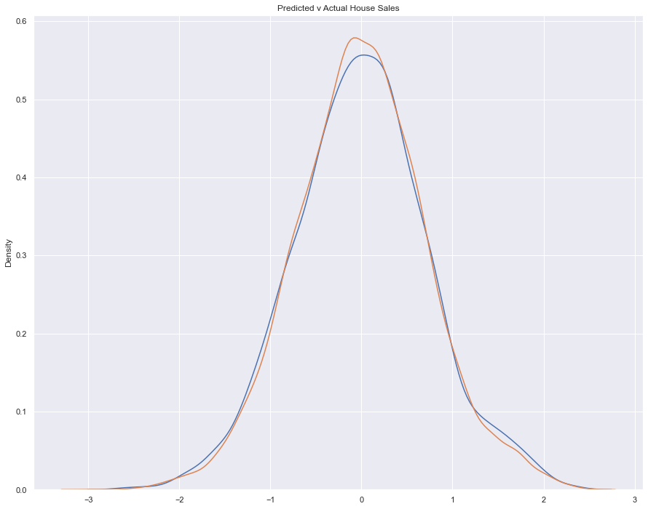
Conclusions
Model 3 provided most reliable result with R^ of 0.524
Selected features all statistically significant with p-value <0.05
sqft living15 coef – 0.2791
sqft living coef – 0.3956
distance from CBD coef - 0.3434
Bathrooms coef – 0.0645
high grade rating coef– 0.4590
These Coef figures mean for unit increase in any one of these variables there was in increase in price by ~0.3 units.

Slide 14
Conclusions
In order to solve this problem, I intended to answer the below questions:
1. Does location impact sale price?
Location does impact the sales price.
2. Does the size of the house impact sale price?
The size of the living area does impact the price.
3. Does quality of the house impact sale price?
The quality (grade) of the house does impact the sale price.

Slide 15
Thank You!
Email: nathaniel.berryman@gmail.com
GitHub: @natberr
LinkedIn: linkedin.com/in/nathaniel-berryman/

